Slide 1
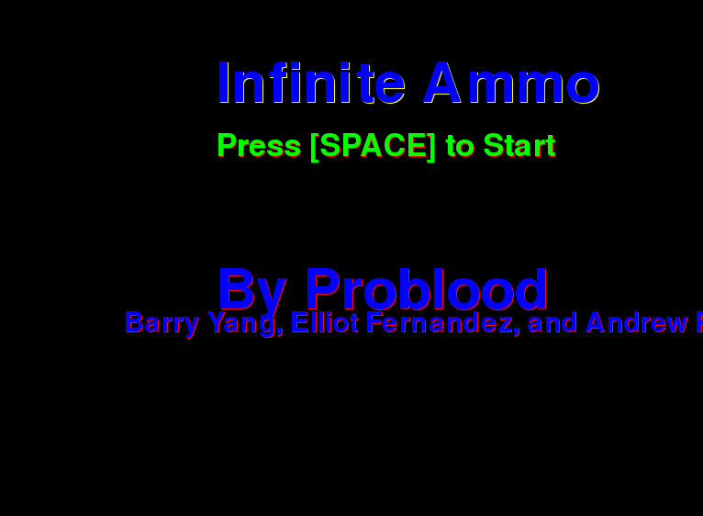
Infinite Ammo
Company: ProBlood
By: Barry Yang, Andrew Park, Elliot Fernandez

Slide 2



Slide 3


Slide 4


Slide 5
